Slide 1
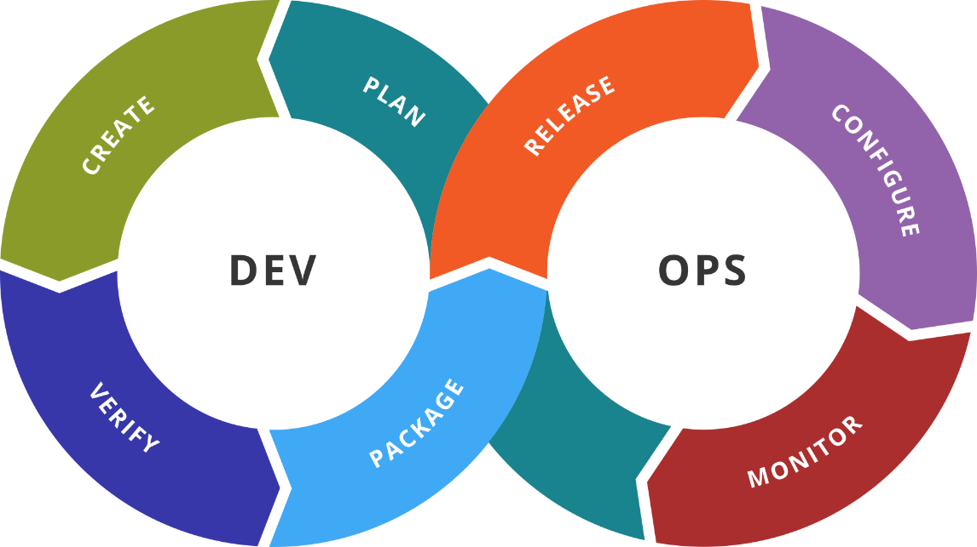
Prometheus and Grafana
SoftUni Team
Technical Trainers
Software University
https://softuni.org

Slide 2
You Have Questions?
sli.do
#DevOps-23
facebook.com
/groups/DevOpsContainerizationCICDMonitoringJanuary2023

Slide 3
Homework Progress
Solutions for M5
can be submitted
until 23:59 on 08.03.2023
Solutions for M6
can be submitted
until 23:59 on 15.03.2023

Slide 4

Previous Module (M5)
Quick Overview

Slide 5
What We Covered
Remote (slave) hosts
Working with Jenkins using CLI
Export and Import jobs
Blue Ocean
SCM integration

Slide 6

Dev
Ops
This Module (M6)
Topics and Lab Infrastructure

Slide 7
Table of Contents
Prometheus
Architecture
Installation and configuration
Information processing and PromQL
Grafana
Installation and configuration
Dashboarding

Slide 8
Lab Infrastructure
NETWORK: 192.168.99.0/24
.101
.102
.103
VM1
VM2
VM3
VirtualBox
Vagrant
Windows / Linux / macOS

Slide 9
Dev
Ops
Prometheus 101
Getting to Know Prometheus

Slide 10
What is Prometheus?
An open-source toolkit for monitoring and alerting
Collects and stores metrics as time series data
Additionally, it can store optional labels (key-value pairs)
Offers flexible query language (PromQL)
Data collection happens via pull model over HTTP
Pushing of data is also supported via an intermediary gateway
Suitable for recording pure numeric time series
Not suitable when we need 100% accuracy (for example, for billing)
https://prometheus.io/docs/introduction/overview/

Slide 11
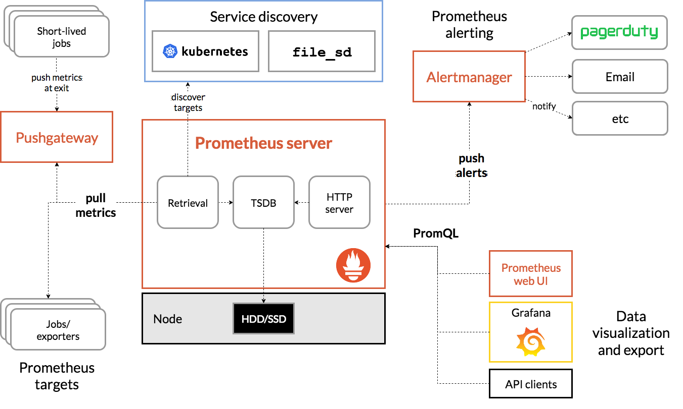
Architecture
https://prometheus.io/docs/introduction/overview/

Slide 12
Install Options
Pre-compiled binaries
Most popular operating systems are supported
Build from source
Using containers
Using configuration management systems
Ansible, Chef, Puppet and Salt
Different components are available as separate artefacts
https://prometheus.io/docs/prometheus/latest/installation/

Slide 13
Prometheus Configuration
Configured via command-line flags and a configuration file
Command-line arguments are used to configure immutable system parameters like storage location, amount, etc.
Configuration file is used to control scraping and rules
The configuration file is in YAML format
It can be reloaded (including any rules) by sending
SIGHUP to the Prometheus process
HTTP POST request to /-/reload endpoint (--web.enable-lifecycle flag)
https://prometheus.io/docs/prometheus/latest/configuration/configuration/

Slide 14
Data Model
Data is sored as time series
Which are streams of timestamped values belonging to the same metric and the same set of labeled dimensions
Every time series is uniquely identified by its metric name and optional key-value pairs called labels
The metric name specifies the general feature of a system that is measured
Labels enable Prometheus's dimensional data model
Any given combination of labels for the same metric name identifies a particular dimensional instantiation of that metric
api_http_requests_total{method="POST", handler="/messages"}
https://prometheus.io/docs/concepts/data_model/

Slide 15
Metric Types
Counter is a cumulative metric that represents a single monotonically increasing counter whose value can only increase or be reset to zero on restart. For example, number of tasks completed, requests served, etc.
Gauge is a metric that represents a single numerical value that can arbitrarily go up and down. For example, temperatures, number of concurrent requests, etc.
Histogram samples observations (like request durations or response sizes) and counts them in configurable buckets. It also provides a sum of all observed values
Summary samples observations (like request durations and response sizes). While it also provides a total count of observations and a sum of all observed values, it calculates configurable quantiles over a sliding time window
https://prometheus.io/docs/concepts/metric_types/

Slide 16
Jobs, Instances, and Samples
An endpoint that we can scrape is called an instance
Usually, it corresponds to a single process
A collection of instances is called a job
When target is scraped, two additional labels are added – job and instance
Each instance scrape adds sample to a set of system time series
A sample is a single value at a point in time in a time series
Each sample consists of a float64 value and a millisecond-precision timestamp
https://prometheus.io/docs/concepts/jobs_instances/

Slide 17
Dev
Ops
Practice: See It in Action
Live Demonstration in Class

Slide 18
Dev
Ops
Prometheus 102
Advanced Tasks

Slide 19
Relabeling
We can utilize two techniques to control the information flow
Target relabeling is a powerful tool to dynamically rewrite the label set of a target before it gets scraped
Metric relabeling is applied to samples as the last step before ingestion
Both share the same configuration format and actions
https://prometheus.io/docs/prometheus/latest/configuration/configuration/#relabel_config

Slide 20
Recording Rules
Allow to precompute frequently needed or computationally expensive expressions and save their result as a new set of time series
Querying the precomputed result will be much faster
Useful for dashboards, which need to query the same expression repeatedly every time they refresh
Stored in rule groups
Rules within a group are run sequentially at a regular interval
https://prometheus.io/docs/prometheus/latest/configuration/recording_rules/

Slide 21
Alerting Rules
Define alert conditions and send notifications about firing alerts to an external service
No matter if the alert condition will result in one or more vector elements at a given point in time, the alert counts as active
They are defined the same way as recording rules
https://prometheus.io/docs/concepts/jobs_instances/

Slide 22
Dev
Ops
PromQL
Introduction

Slide 23
PromQL
PromQL = Prometheus Query Language
It allows to select and aggregate time series data in real time
The result of an expression can either be
shown as a graph
viewed as tabular data
consumed by external systems via the HTTP API
in Prometheus's expression browser
https://prometheus.io/docs/concepts/jobs_instances/

Slide 24
Expression Data Types
Expressions and sub-expressions evaluate to one of the following
Scalar - a simple numeric floating-point value
String - a simple string value; currently unused
Instant vector - a set of time series containing a single sample for each time series, all sharing the same timestamp
Range vector - a set of time series containing a range of data points over time for each time series
https://prometheus.io/docs/concepts/jobs_instances/

Slide 25
Vector Selectors
Instant vector selectors allow the selection of a set of time series and a single sample value for each at a given timestamp (instant)
Range vector selectors work the same way but for a range
A time range is appended at the end of the selector
It specifies how far back in time values should be fetched
http_requests_total # all time series with the specified metric name
http_requests_total[5m] # values for the 5 minutes
https://prometheus.io/docs/prometheus/latest/querying/basics/#time-series-selectors

Slide 26
Selectors and Label Matchers
We can select just some of the time series for a metric with exact match
Other operators include not equal (!=)
regex-match (=~)
and not regex-match (!~)
http_requests_total{job="web",os="win"}
http_requests_total{job="web",method!="POST"}
http_requests_total{job="web",environment=~"stage|dev|test"}
http_requests_total{job="web",host!~".*dev.*"}
https://prometheus.io/docs/prometheus/latest/querying/basics/#time-series-selectors

Slide 27
Time Durations and Modifiers
Time durations (ms, s, m, h, d, w, y) are specified like [5m] and can be concatenated
Offset modifier can be used to change the start point in time
@ modifier is used to change the evaluation time for individual instant and range vectors
Offset and @ can be combined. In addition, we can use the start() and end() functions
http_requests_total{job="prometheus"}[1h5m] # values for the last hour and 5 minutes
http_requests_total offset 5m # value as of 5 minutes ago
http_requests_total offset 5m @ 1646937045 # value as of 5 min before 20:30:45
# on 10.03.2022
https://prometheus.io/docs/prometheus/latest/querying/basics/#time-series-selectors

Slide 28
Operators *
Arithmetic binary operators (+, -, *, /, %, ^) between scalar/scalar, vector/scalar, and vector/vector value pairs
Comparison binary operators (==, !=, >, <, >=, <=) between scalar/scalar, vector/scalar, and vector/vector value pairs
Logical/set binary operators (and, or, unless) between instant vectors
Aggregation operators (sum, min, max, avg, etc.) on a single instant vector
(1) Trigonometric binary operators are omitted from the list above
(2) Operations between vectors attempt to find a matching element in the right-hand side vector for each
entry in the left-hand side. Two types of matching behavior - one-to-one and many-to-one/one-to-many.
https://prometheus.io/docs/prometheus/latest/querying/operators/

Slide 29
Dev
Ops
Alerting
Introduction

Slide 30
Alerting
Separated into two parts
Alerting rules in Prometheus servers send alerts to an Alertmanager
Then it manages those alerts including silencing (mute), inhibition (suppress), aggregation (group), and sending out notifications
Notification methods include email, on-call notification systems, and chat platforms

Slide 31
Configuration
Configured via command-line flags and a configuration file
Command-line arguments are used to configure immutable system parameters
Configuration file defines inhibition rules, notification routing and notification receivers
The visual editor can assist in building routing trees
The configuration file is in YAML format
It can be reloaded (including any rules) by sending
SIGHUP to the Prometheus process
HTTP POST request to /-/reload endpoint (--web.enable-lifecycle flag)
https://prometheus.io/docs/prometheus/latest/configuration/configuration/

Slide 32
Dev
Ops
Practice: See It in Action
Live Demonstration in Class

Slide 33
Dev
Ops
Grafana
Getting to Know Grafana

Slide 34
Introduction to Grafana
Grafana is a complete observability stack
Monitor and analyze metrics, logs and traces
Query, visualize, alert on and understand our data
Create, explore, and share beautiful dashboards
Offered in three variants – open source, cloud, and enterprise
Includes additional components like Loki and Tempo

Slide 35
Installation (on-prem)
Native packages (for various Linux distributions)
Windows installation either with installer or binary
macOS via Homebrew or standalone binaries
Docker image – Alpine or Ubuntu based
Supported databases are SQLite, MySQL, and PostgreSQL
Supported browsers are Chrome, Firefox, Safari, and Edge

Slide 36
Administration
Server level settings are spread across three files defaults.ini, grafana.ini, and custom.ini
We can control the instance and the server
There is Grafana CLI which can be used to automate stuff
It can be set up for high availability

Slide 37
Data Sources
Most popular are supported out of the box
Prometheus, Graphite, OpenTSDB, and InfluxDB
Loki and Elasticsearch
MySQL, PostgreSQL, MicrosoftSQL
Cloud services
Many enterprise and third-party plugin

Slide 38
Panels. Visualizations. Dashboards
Panels are the building blocks of dashboards
They connect via query to a data source
On them we use different visualizations
Those can be time series, charts, gauges, tables, etc.
We then assemble panels as a dashboard

Slide 39
Dev
Ops
Practice: See It in Action
Live Demonstration in Class

Slide 40

Resources
Prometheus
https://prometheus.io/
Prometheus documentation
https://prometheus.io/docs/introduction/overview/
Grafana
https://grafana.com/
Grafana documentation
https://grafana.com/docs/grafana/latest/
…
…
…

Slide 41
Questions?
Notes:
41

Slide 42














SoftUni Diamond Partners

Slide 43

Educational Partners

Slide 44

License
This course (slides, examples, demos, exercises, homework, documents, videos and other assets) is copyrighted content
Unauthorized copy, reproduction or use is illegal
© SoftUni – https://softuni.org
© Software University – https://softuni.bg
Notes:
44

Slide 45
Trainings @ Software University (SoftUni)
Software University – High-Quality Education, Profession and Job for Software Developers
softuni.bg, softuni.org
Software University Foundation
softuni.foundation
Software University @ Facebook
facebook.com/SoftwareUniversity
Software University Forums
forum.softuni.bg
Notes:
45

